Slide 1
Halting Problem
Group 6
Devansh Shah - 1914078
Kevin Joshi - 1914092
Kaushal Binjola - 1914094

Slide 2
Kaushal Binjola
The origins of the halting problem
1936 Turing’s Paper Published
2004 Copeland’s Discovery
1958 Martin’s Book
Turing’s paper was published in 1936, credits and proof of the Halting Problem were attributed to Turing
In 2004, Copeland discovered that no paper or book till 1958 had any mention of Halting Problems. The first mention was in a 1958 book by Martin Davis
Martin published his book in 1958, which defined as well as explained the Halting problem that is so profound and well known today.
Many papers and textbooks refer the definition and proof of undecidability of the halting problem to ‘On computable numbers, with an application to the Entscheidungsproblem’ by Turing.
Although “it is often said that Turing stated and proved the halting problem in his 1936 paper”, it was named and originally stated by Martin Davis
FACT!

Slide 3
Kaushal Binjola
Facts on why Davis is to be Credited
Conceptual Difference
Martin’s and Turing’s notion of Computability in itself gives us the major fact necessary to prove our claim.
Turing
Martin
M.D. Davis in Computability and Unsolvability, gave the definition as: By a computation of a Turing machine M is meant a finite sequence of instantaneous descriptions α1,…,αp such that αi→αi+1 for 1≤i<p and such that αp is terminal with respect to M. The key point here is that the last instantaneous description αp must be terminal, i.e., no transition is possible from it. In other words, “The machine interprets the absence of an instruction as a stop order” When reaching αp. This is the usual notion of computation with TMs today.
Turing’s notion of computation pays no attention to any halting behaviour. if the machine is supplied with a blank tape and set in motion, starting from the correct initial m-configuration, the subsequence of the symbols printed by it which are of the first kind will be called the sequence computed by the machine. The fact that Turing's partition of his machines pays no special attention to any halting behavior suggests that, at least in ‘On computable ..’, he was not particularly interested in investigating halting machines.
!=

Slide 4
Kaushal Binjola
Facts on why Davis is to be Credited
Decision Problem
Bibliographical analysis
While discussing turing machines, Turing and Davis talked about completely different problems
The (necessarily incomplete) analysis of the literature about computability and undecidability for the period from 1936 to 1958 shows that, apparently, the term “halting problem” was not used before the publication of M.D. Davis Computability and Unsolvability. A number of journals and repositories in the fields of mathematics, logic, and computer science with facilities to search for (prefixes of) words in their archives were considered and ‘halt’ tried on the corresponding search devices for the period 1936-1958.
Turing
Martin
Turing discussed 2 problems
Satisfactory Problem
Printing Problem
Discussed a main major problem
Halting Problem
!=
Davis introduced both Halting and Printing problem and calls printing problem as one related to halting. His definition of Printing problem matched with halting problem further proving that the 2 problems are different

Slide 5
Problems with Halting Problem
Kevin Joshi
Various mathematical derivation were studied such as “Calumation Problem”, “Rusell’s Barber”, “Oracle halting problem”, “Specification halting problem”, “Mimic halting problem”, “Simple halting problem”...
The common problem observed due to the “H” function that leads to uncertainty.
The “H” function returns true or false but the function can either be an infinitely recursive function or call an infinitely recursive function or contain a block of code which run infinitely.
This function “H” is explained on the next slide in one of the mathematical derivations studied in the whole paper. Various derivations use various function names but the functionality at the end remains the same. ( i.e. infinite running of the program )

Slide 6
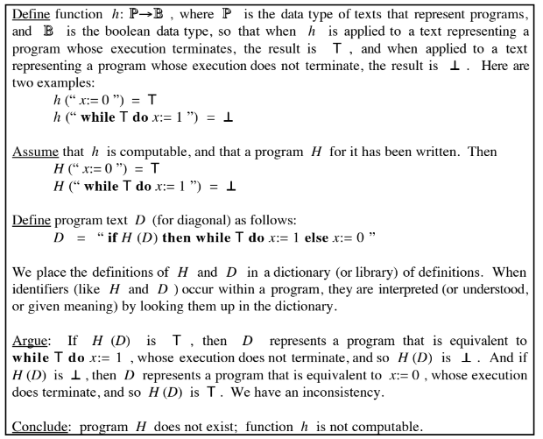
Kevin Joshi

Slide 7
Problems with Halting Problem
Kevin Joshi
It is difficult to compute that a program is going to end up being infinite since the input variables that are provided to that function/program are only determined on execution.
In today’s time most of the programs are dependent on the input variables which are either provided by a program or a user. There could be cases where the user does not provide the input at all leading to a case of infinity or the input provided is such that it doesn't change on recall of the same function leading to the case of infinity.
This uncertainty in the program cannot be computed and can only be determined on the execution of the program which when done beats the case and results in halting problem.
Hence, mathematically this inconsistency was derived and proved from various cases that the inconsistency is next to impossible to detect before executing the program leading into no feasible solution of the halting problem.

Slide 8
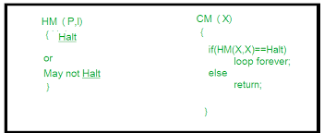
Approximations to Halting Problem
Devansh Shah
We cannot design a generalized algorithm which can appropriately say that given a program will ever halt or not.The only way is to run the program and check whether it halts or not.
One way to define Halting problem with respect to programming is:
A Godelization ϕ is a sequence of all partial recursive functions s.t.
– there exists a partial universal program u with ϕu(hi,xi) = ϕi(x)
– and a total program s with ϕs(hi,xi) (y) = ϕi(hx,yi)
– for a bijective computable function h<·,·>i : Σ ∗ ×Σ ∗ → Σ ∗ or h<·,·>i : N×N → N. called pairing function. The Halting problem for ϕ is Hϕ = {hi,xi: x ∈dom(ϕi)}

Slide 9
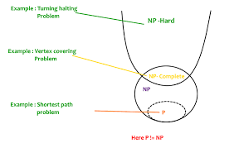
Approximations to Halting Problem
Devansh Shah
Many practical programming languages lacking density in fact do admit such an approximation with asymptotically vanishing relative error for the simple reason that the fraction of syntactically incorrect instances tends to 1.
The question for approximation the Halting problem is equivalent to a mere syntax check and thus becomes trivial and vain.
Hence, there have been several propositions and proofs trying to sharpen the approximation in order to get a close estimate of the halting problem’s solution.

Slide 10
Conclusion
From the three research papers, we can conclude that we learnt about the halting problem in a flow.
Firstly, we saw the history of halting problem and how the credit should go to Martin Davis for defining the halting problem.
Furthermore, we studied about the problems faced in the halting problem that lead to the unsolvability and or inconsistency of the halting problem.
Finally, we learnt about the way to solve the problem just to realize that there is no algorithm that gives the exact solution. Hence, we studied different propositions and definitions to sharpen the approximations to the halting problem.

Slide 11
References
Salvador Lucas, The origins of the halting problem, Journal of Logical and Algebraic Methods in Programming, Volume 121, 2021, 100687, ISSN 2352-2208, https://doi.org/10.1016/j.jlamp.2021.100687.
E.C.R.Hehner: Problems with the Halting Problem, COMPUTING2011 Symposium on 75 years of Turing Machine and Lambda-Calculus, Karlsruhe Germany, invited, 2011 October 20-21 Advances in Computer Science and Engineering v.10 n.1 p.31-60, 2013
Nancy Lynch, Approximations to the Halting Problem, Mathematics Department, University of Southern California, Los Angeles, California 90007 Received January 27, 1973

Slide 12
THANK YOU
Devansh Shah - 1914078
Kevin Joshi - 1914092
Kaushal Binjola - 1914094

